Slide 1
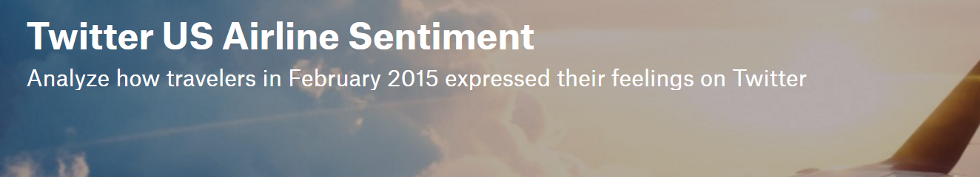
MSBA 6420 Project Presentation
Arpit Sidana
Rohit Nadgiri
Russell Nour
Sandeep Chitta

Slide 2
Agenda
Business Understanding
Data Understanding and Data Preparation
Modelling
Evaluation
Model Deployment

Slide 3
Business Understanding
Classify the sentiment (positive, negative, or neutral) of airline customer tweets for six major U.S. airlines and then classify the reason for the negative sentiment
Use Case
Address customer concerns in real time and thus deal with potentially deleterious situations
Expert support team can respond to tweets with negative sentiment
With inflow of 6000 tweets/sec, big data technologies like Apache Spark can support real time analytics
Business Understanding Data Preparation Modelling Evaluation Deployment

Slide 4
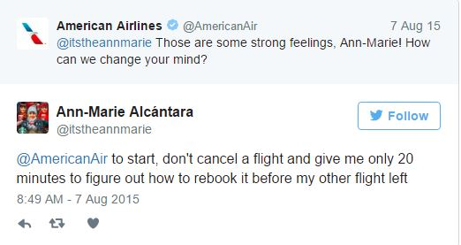
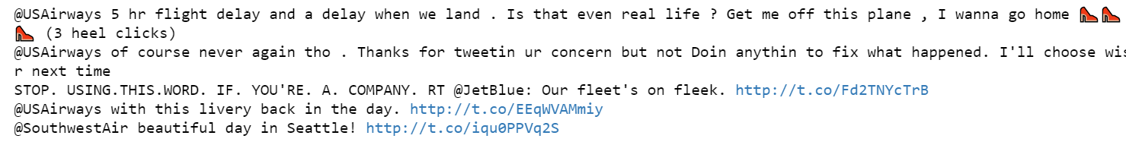
What happens if this goes viral?
Top 5 retweets
Business Understanding Data Preparation Modelling Evaluation Deployment

Slide 5
Value add
Classify tweet sentiment in a relatively fast and automated fashion
Identify dissatisfied customers early on (including reasons)
Improve the customer's overall airline experience
Reduce customer churn
Business Understanding Data Preparation Modelling Evaluation Deployment

Slide 6
Data Understanding
 | 1st Model(Sentiment) | 2nd Model(Reason)
Number of Instances | 14640 | 9178
Number of features | 20 | 20
Target Class | 3 | 10
Types of Variables | categorical, numerical and ordinal
Model class instances:
1st Model (Sentiment): “positive”, “negative” or “neutral”
2nd Model (Reason): “Bad Flight”, “Can't Tell”, “Late Flight”, “Customer Service Issue”, ”Flight Booking Problems”, “Lost Luggage”, “Flight Attendant Complaints”, “Cancelled Flight”, “Damaged Luggage” and ”longlines”
Business Understanding Data Preparation Modelling Evaluation Deployment
Notes:
Screenshot of actual data and talk about various attributes
Word cloud on different slide

Slide 7
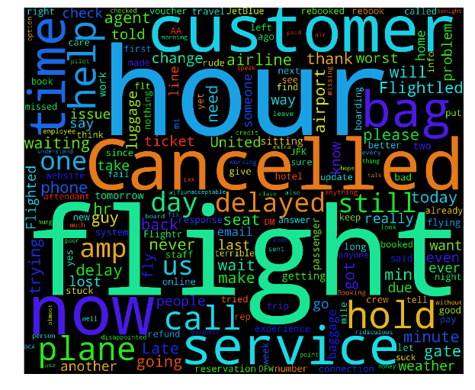
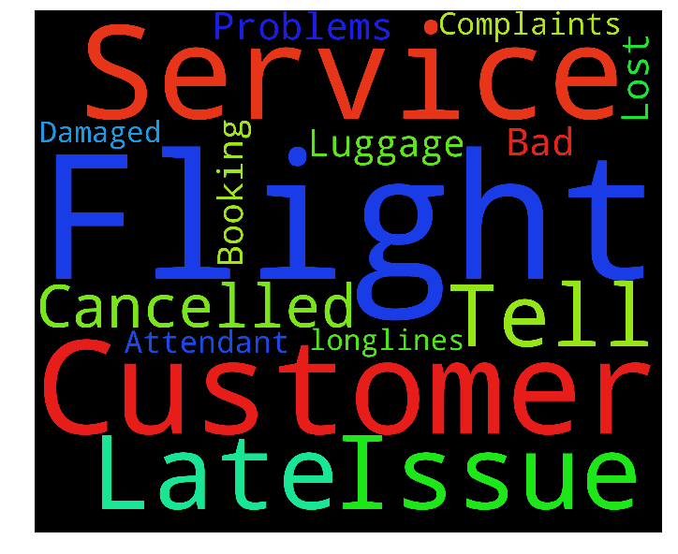
Word Cloud
1st Model (Sentiment)
2nd Model (Reason)
Business Understanding Data Preparation Modelling Evaluation Deployment
Notes:
Screenshot of actual data and talk about various attributes
Word cloud on different slide

Slide 8
Data Preparation
Textual feature selection - Missing Values not a concern
Encoded target variables (for both models)
Dummy variables (Binary features)
Business Understanding Data Preparation Modelling Evaluation Deployment
Notes:
Few a method of scikit accept target variable in numerical format and so encoded that target variable

Slide 9
Feature Engineering
Dictionary (Positive / Negative)
Bag of words - Word Count
Sarcasm
Observed positive + any negative words
Word Sentiment (VaderSentiment)
Positive, Neutral, Negative scores
UpperCase
Proxy for extreme tone (shouting)
Special Characters (continuity)
Length of 2 or more for extremes (!! or ???)
Emojis(😒😓😔😕😖)
Features based on count in tweet
~200 features
Business Understanding Data Preparation Modelling Evaluation Deployment

Slide 10
Data Pre-processing
Tokenization
Lemmatization
Stop words
Punctuation removal
Lower case conversion
Most/Least frequent words
Alphanumeric and numeric words: “05AM” and “10”
Word length > 1
N-gram (bigram) generation
Business Understanding Data Preparation Modelling Evaluation Deployment

Slide 11
Modelling (10 fold cross validation)
Naive Bayes
Logistic Regression
Extra Tree Classifier
Linear Support Vector Machines (SGD Classifier)
Decision Tree
Bagging Classifier
AdaBoost Classifier
Business Understanding Data Preparation Modelling Evaluation Deployment

Slide 12
Model Evalutaion
1st Model (Sentiment)
F-measure of negative sentiments
Higher misclassification cost
Accuracy
Incorrect measure
2nd Model (Reason)
Accuracy
Assumed equal costs across all classes
Business Understanding Data Preparation Modelling Evaluation Deployment

Slide 13
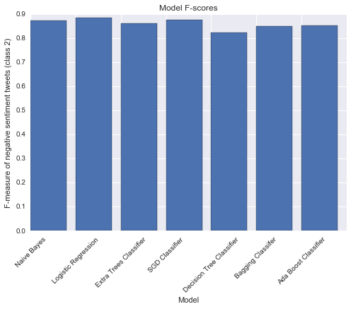
1st Model (Sentiment) Performance
Logistic Regression performs the best, followed by Linear Support Vector Machines
Business Understanding Data Preparation Modelling Evaluation Deployment

Slide 14
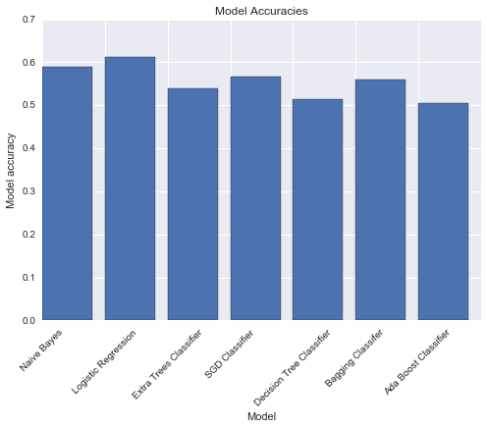
2nd Model (Reason) Performance
Logistic Regression performs the best, followed by Naive Bayes
Business Understanding Data Preparation Modelling Evaluation Deployment

Slide 15
Why Naïve Bayes?
Efficient in terms of both storage space and computation time
Incremental learner
With more tweets, model can be continuously improved
Less time to build / learn
Inflow of tweets at 6000/sec
Business Understanding Data Preparation Modelling Evaluation Deployment

Slide 16
Deployment
Issues / Risk involved
Contextual meaning of text
Tweets that contain tag of ‘@’
Not every tweet with negative sentiment will be captured
Risk Mitigation plan
Model to capture tagged word strings alongwith of ‘@’
Artificial Intelligence can be explored to handle contextual meaning
Ethical Concerns
Cheating
Perception of unfairness (treated equally)
Business Understanding Data Preparation Modelling Evaluation Deployment

Slide 17
Thank You

